Slide 1

TEAM CLOUD OPTIMIZERS An OpenSimplex approach : Hadoop performance optimization by auto tuning default configuration parameter
VINAY KHEDEKAR TEJAS GHALSASI MOMTAZ AFREDI

Slide 2
Agenda
Technical Setup
Hadoop
Map Reduce
Configurations
Technical Design & Implementation

Slide 3
Technical Setup
Hadoop Setup follows a series of steps which will be demonstrated in the following slides.

Slide 4
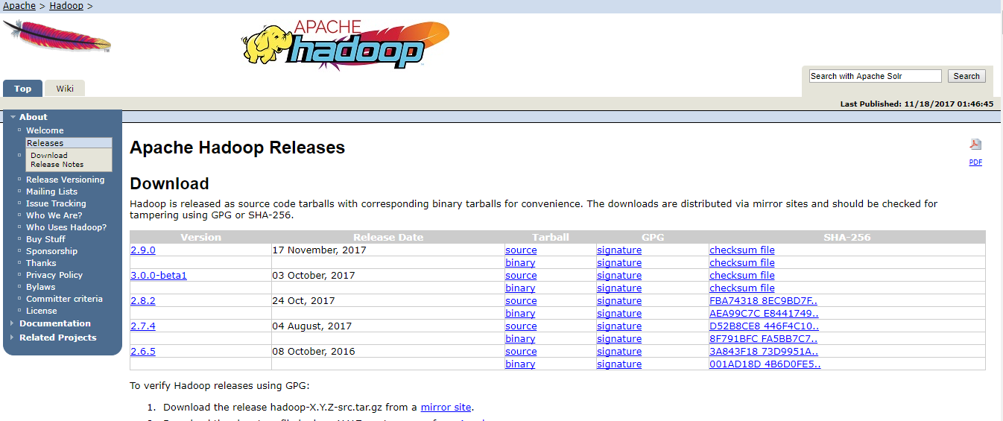
Hadoop Setup
Download Hadoop 2.8.x(Stable) from Apache Hadoop Website

Slide 5
Hadoop Setup
Unzip the Files using file extraction software into /usr/local/Hadoop-2.8.x/
Install Java and SSH
Set up the following main files:
~/.bashrc
/usr/local/hadoop/etc/hadoop/hadoop-env.sh
/usr/local/hadoop/etc/hadoop/core-site.xml
/usr/local/hadoop/etc/hadoop/mapred-site.xml.template
/usr/local/hadoop/etc/hadoop/hdfs-site.xml

Slide 6
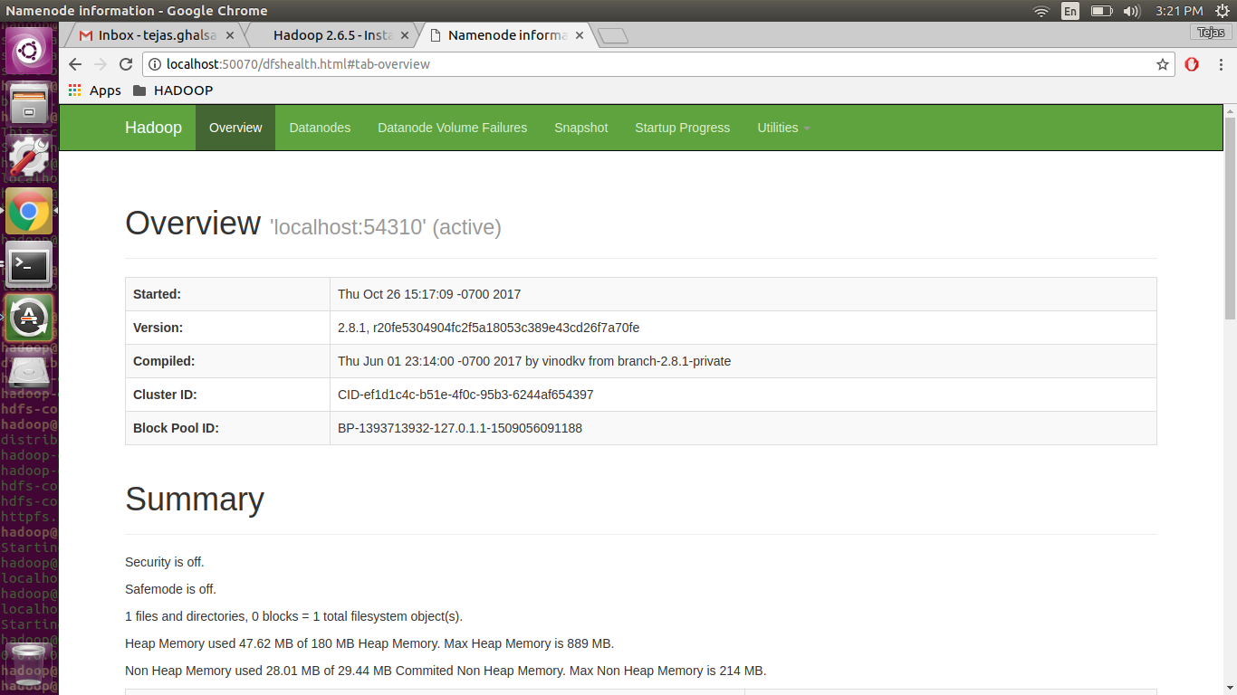
Once Everything is correctly Setup you should see this when you access the localhost

Slide 7
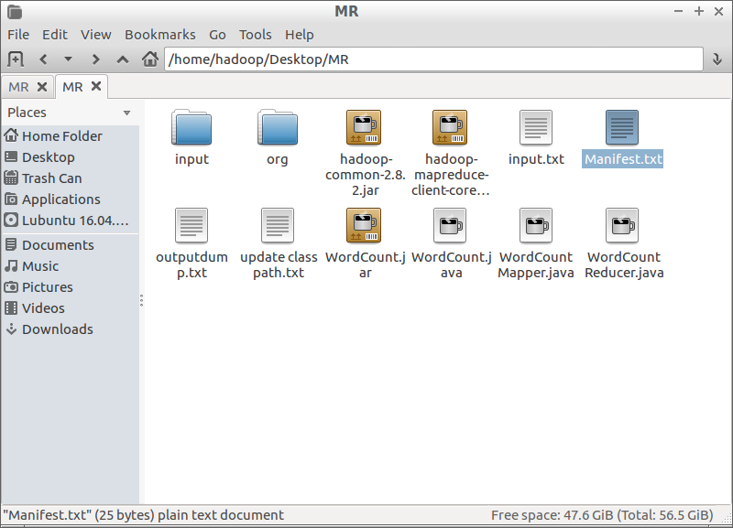
MAP Reduce Folder should look like:
Move the Shakespeare Literature text file inside the HDFS

Slide 8
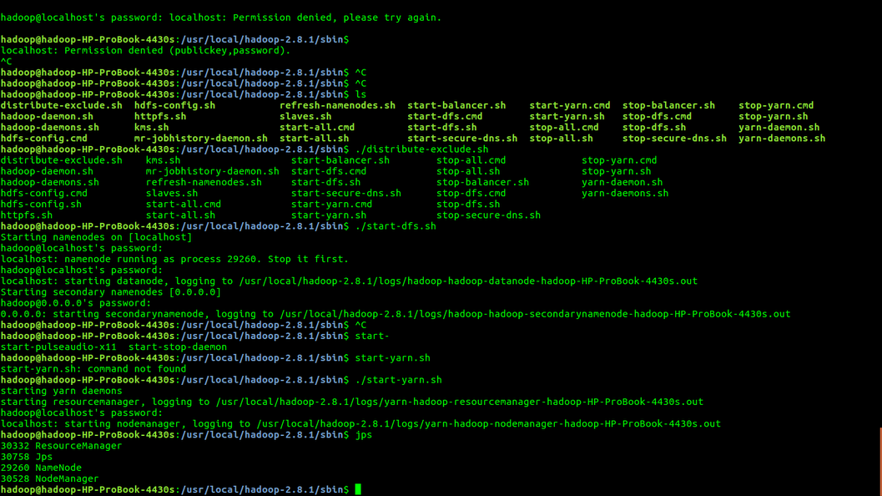
Map Reduce
The Map Reduce classes need to be packed in a jar fire
The jar file is to be added to the class path

Slide 9
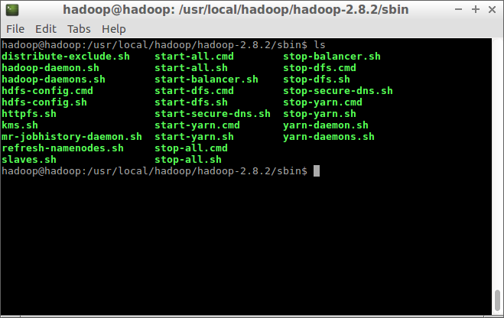
Go to Sbin and Execute

Slide 10
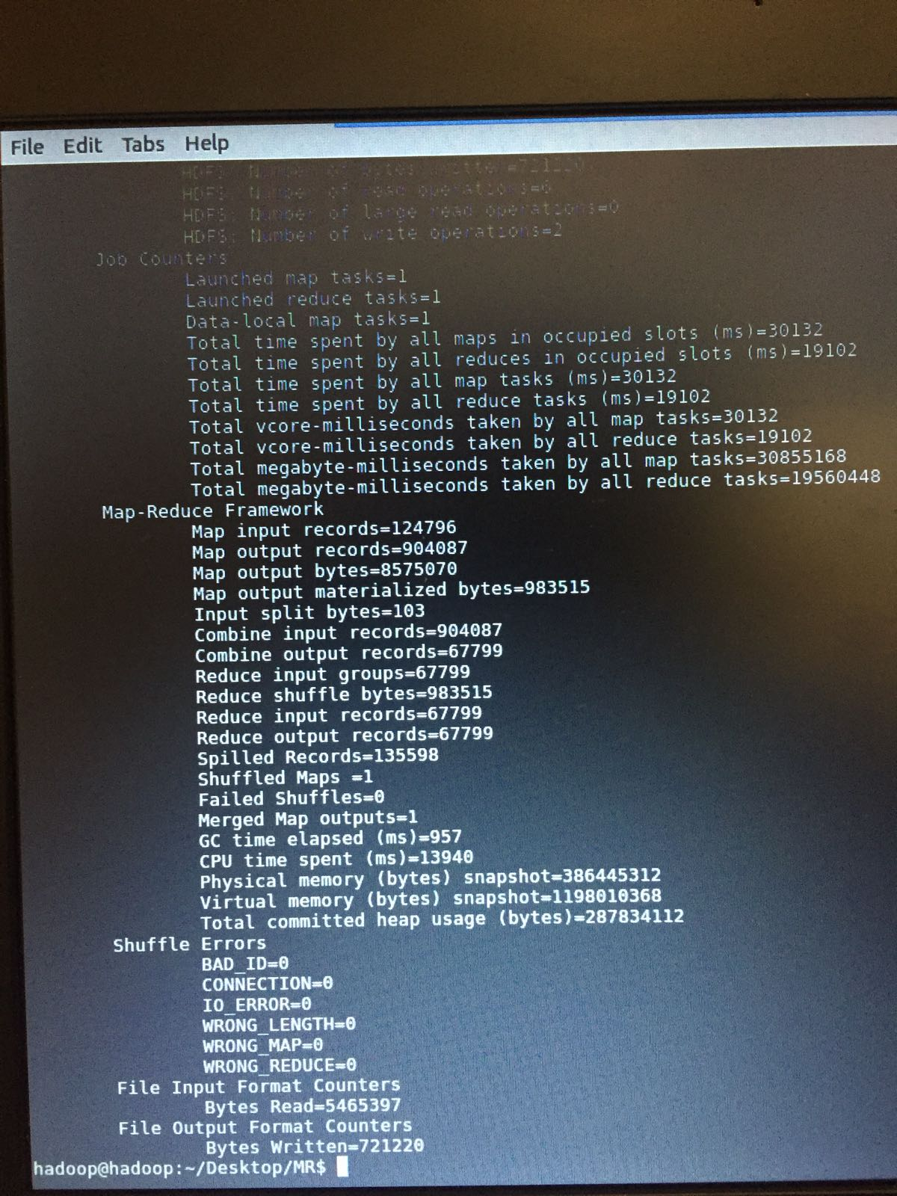
Execution

Slide 11
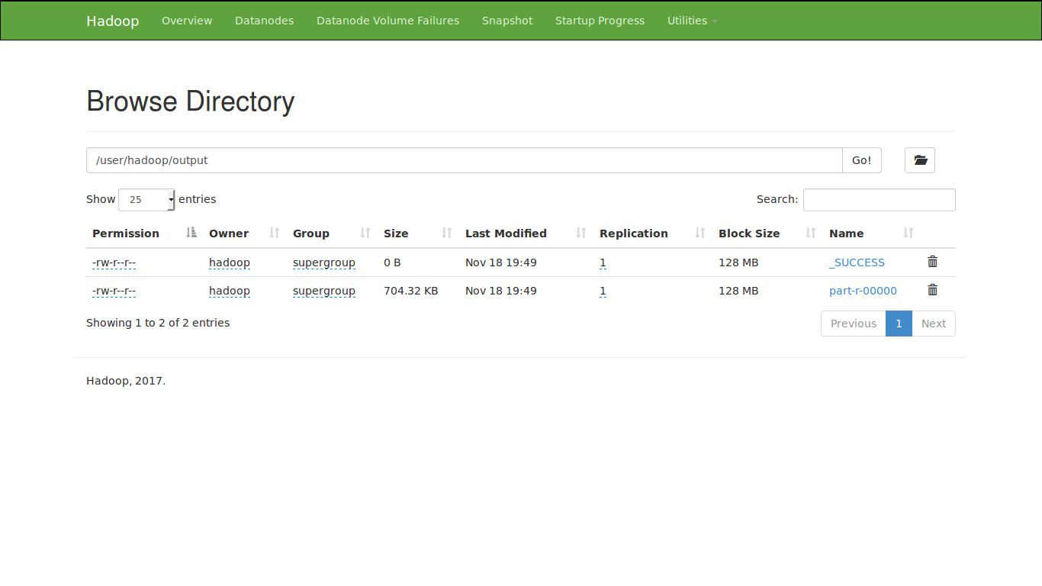
Output on the Web monitor

Slide 12
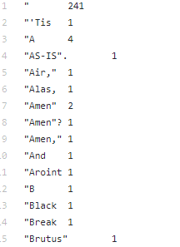
Mined Text File Screenshot
https://goo.gl/iAJSck

Slide 13
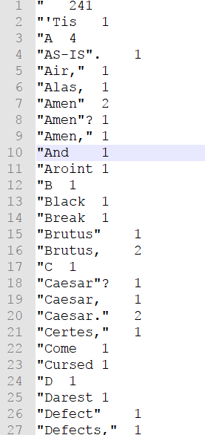
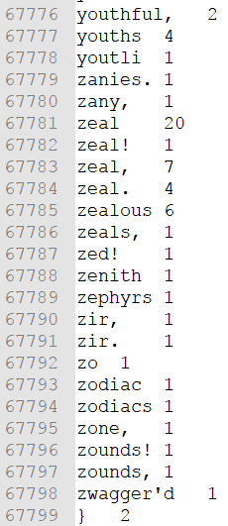
Mined Text File Screenshot

Slide 14


HADOOP | MAPREDUCE

Slide 15
The Job Profiler
Gathers the job history files, the task profiles
It Generates the job profile
Build and return the job identifier (e.g., job_23412331234_1234)
Static methods for enabling and performing MapReduce job profiling.
There are couple of methods are inside this class that will enable static and dynamic profiling using the BTraceTaskProfile and BTraceTaskMemProfile scripts for all the job tasks.
The output is sent to the Optimizer for further .

Slide 16

THANK YOU ALL!

